Slide 1

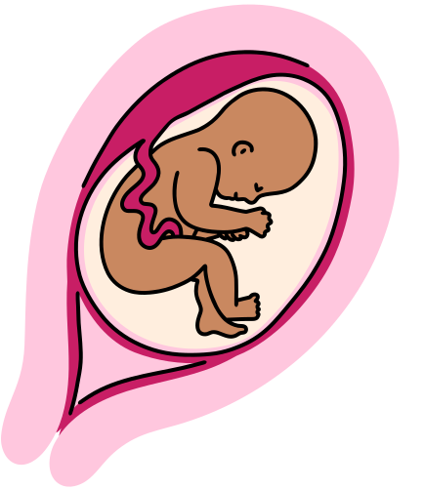
PulseGuard
Presented by Team PulseGuard

Slide 2

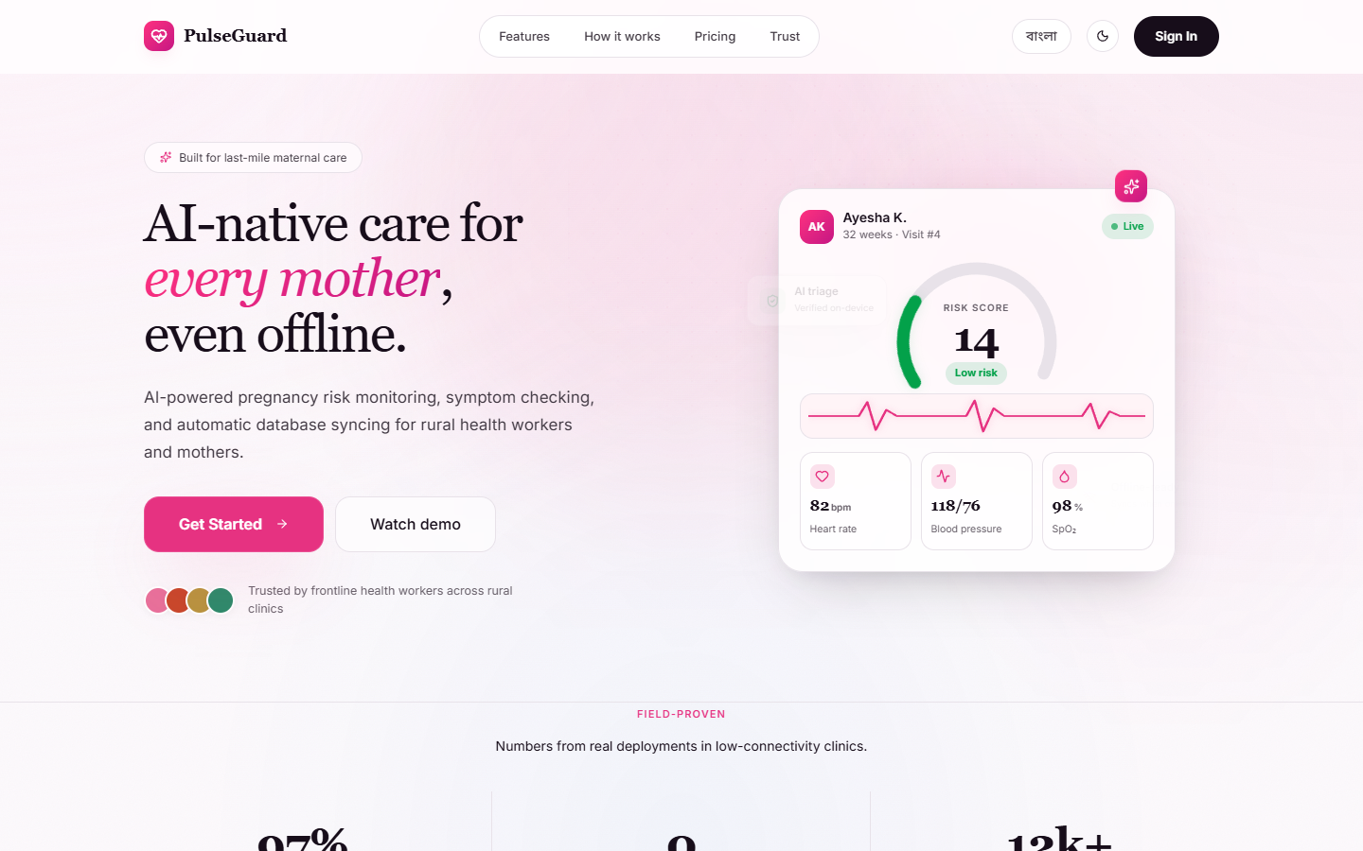

Preparing for a Healthy Journey Ahead
PulseGuard is an AI-native maternal health platform designed to support every mother through her pregnancy journey. From tracking vital signs to AI-powered health insights, PulseGuard brings personalized, evidence-based care to your fingertips — ensuring you and your baby stay safe and healthy at every stage.

Slide 3
[ Add RAG diagram here ]
RAG Mechanism
PulseGuard uses Retrieval-Augmented Generation (RAG) to deliver clinically grounded AI responses. When a patient or health worker asks a question, the RAG engine first retrieves the most relevant records from the patient's health history — including vitals, visit notes, lab results, and risk flags. These retrieved documents are passed as context to the AI model, which generates a response specific to that patient. This eliminates hallucination and ensures every recommendation is grounded in verified, real-world patient data.

Slide 4
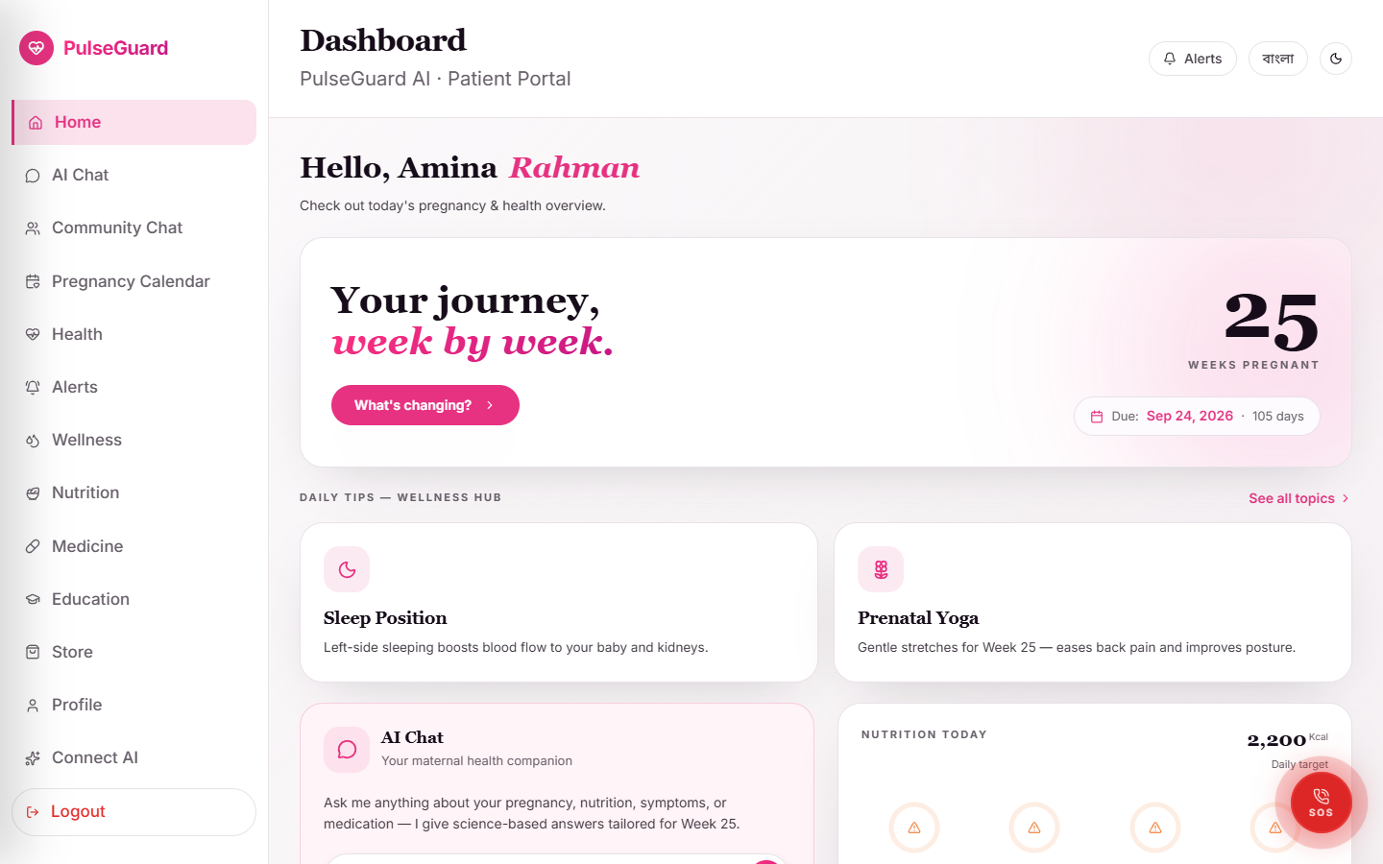
Healthy Start for a Happy Pregnancy
The first trimester sets the foundation for a healthy pregnancy. Start prenatal vitamins with folic acid (400 mcg daily) to support fetal development and reduce birth defects. Eat a balanced diet rich in fruits, vegetables, lean proteins, and whole grains, and stay hydrated by drinking 8-10 glasses of water daily. Get regular check-ups with your healthcare provider to monitor vital signs and fetal development, and track your health metrics including blood pressure, weight, and blood sugar — especially if you are at risk for complications.

Slide 5
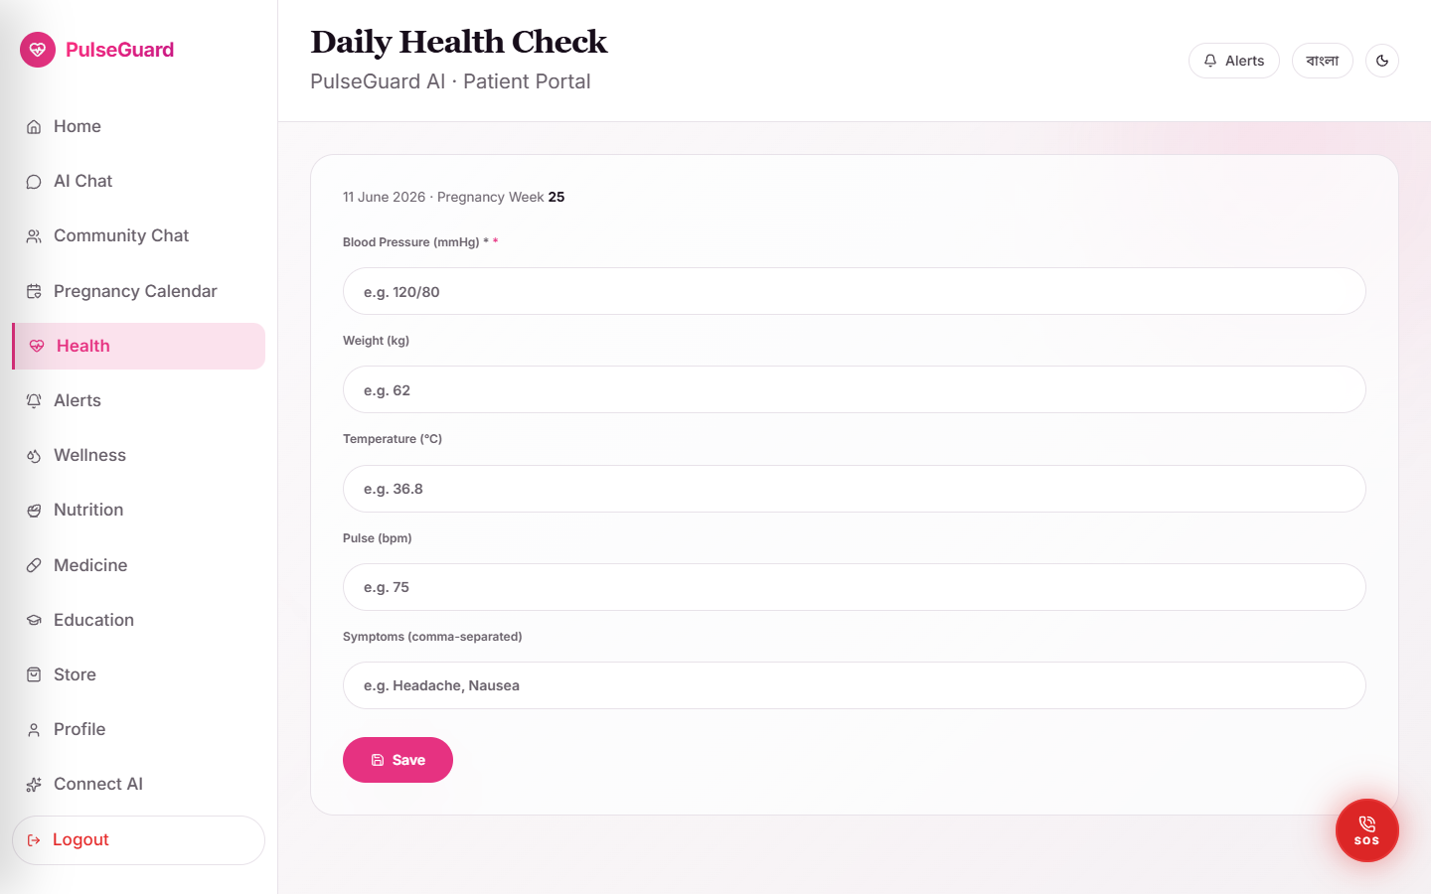
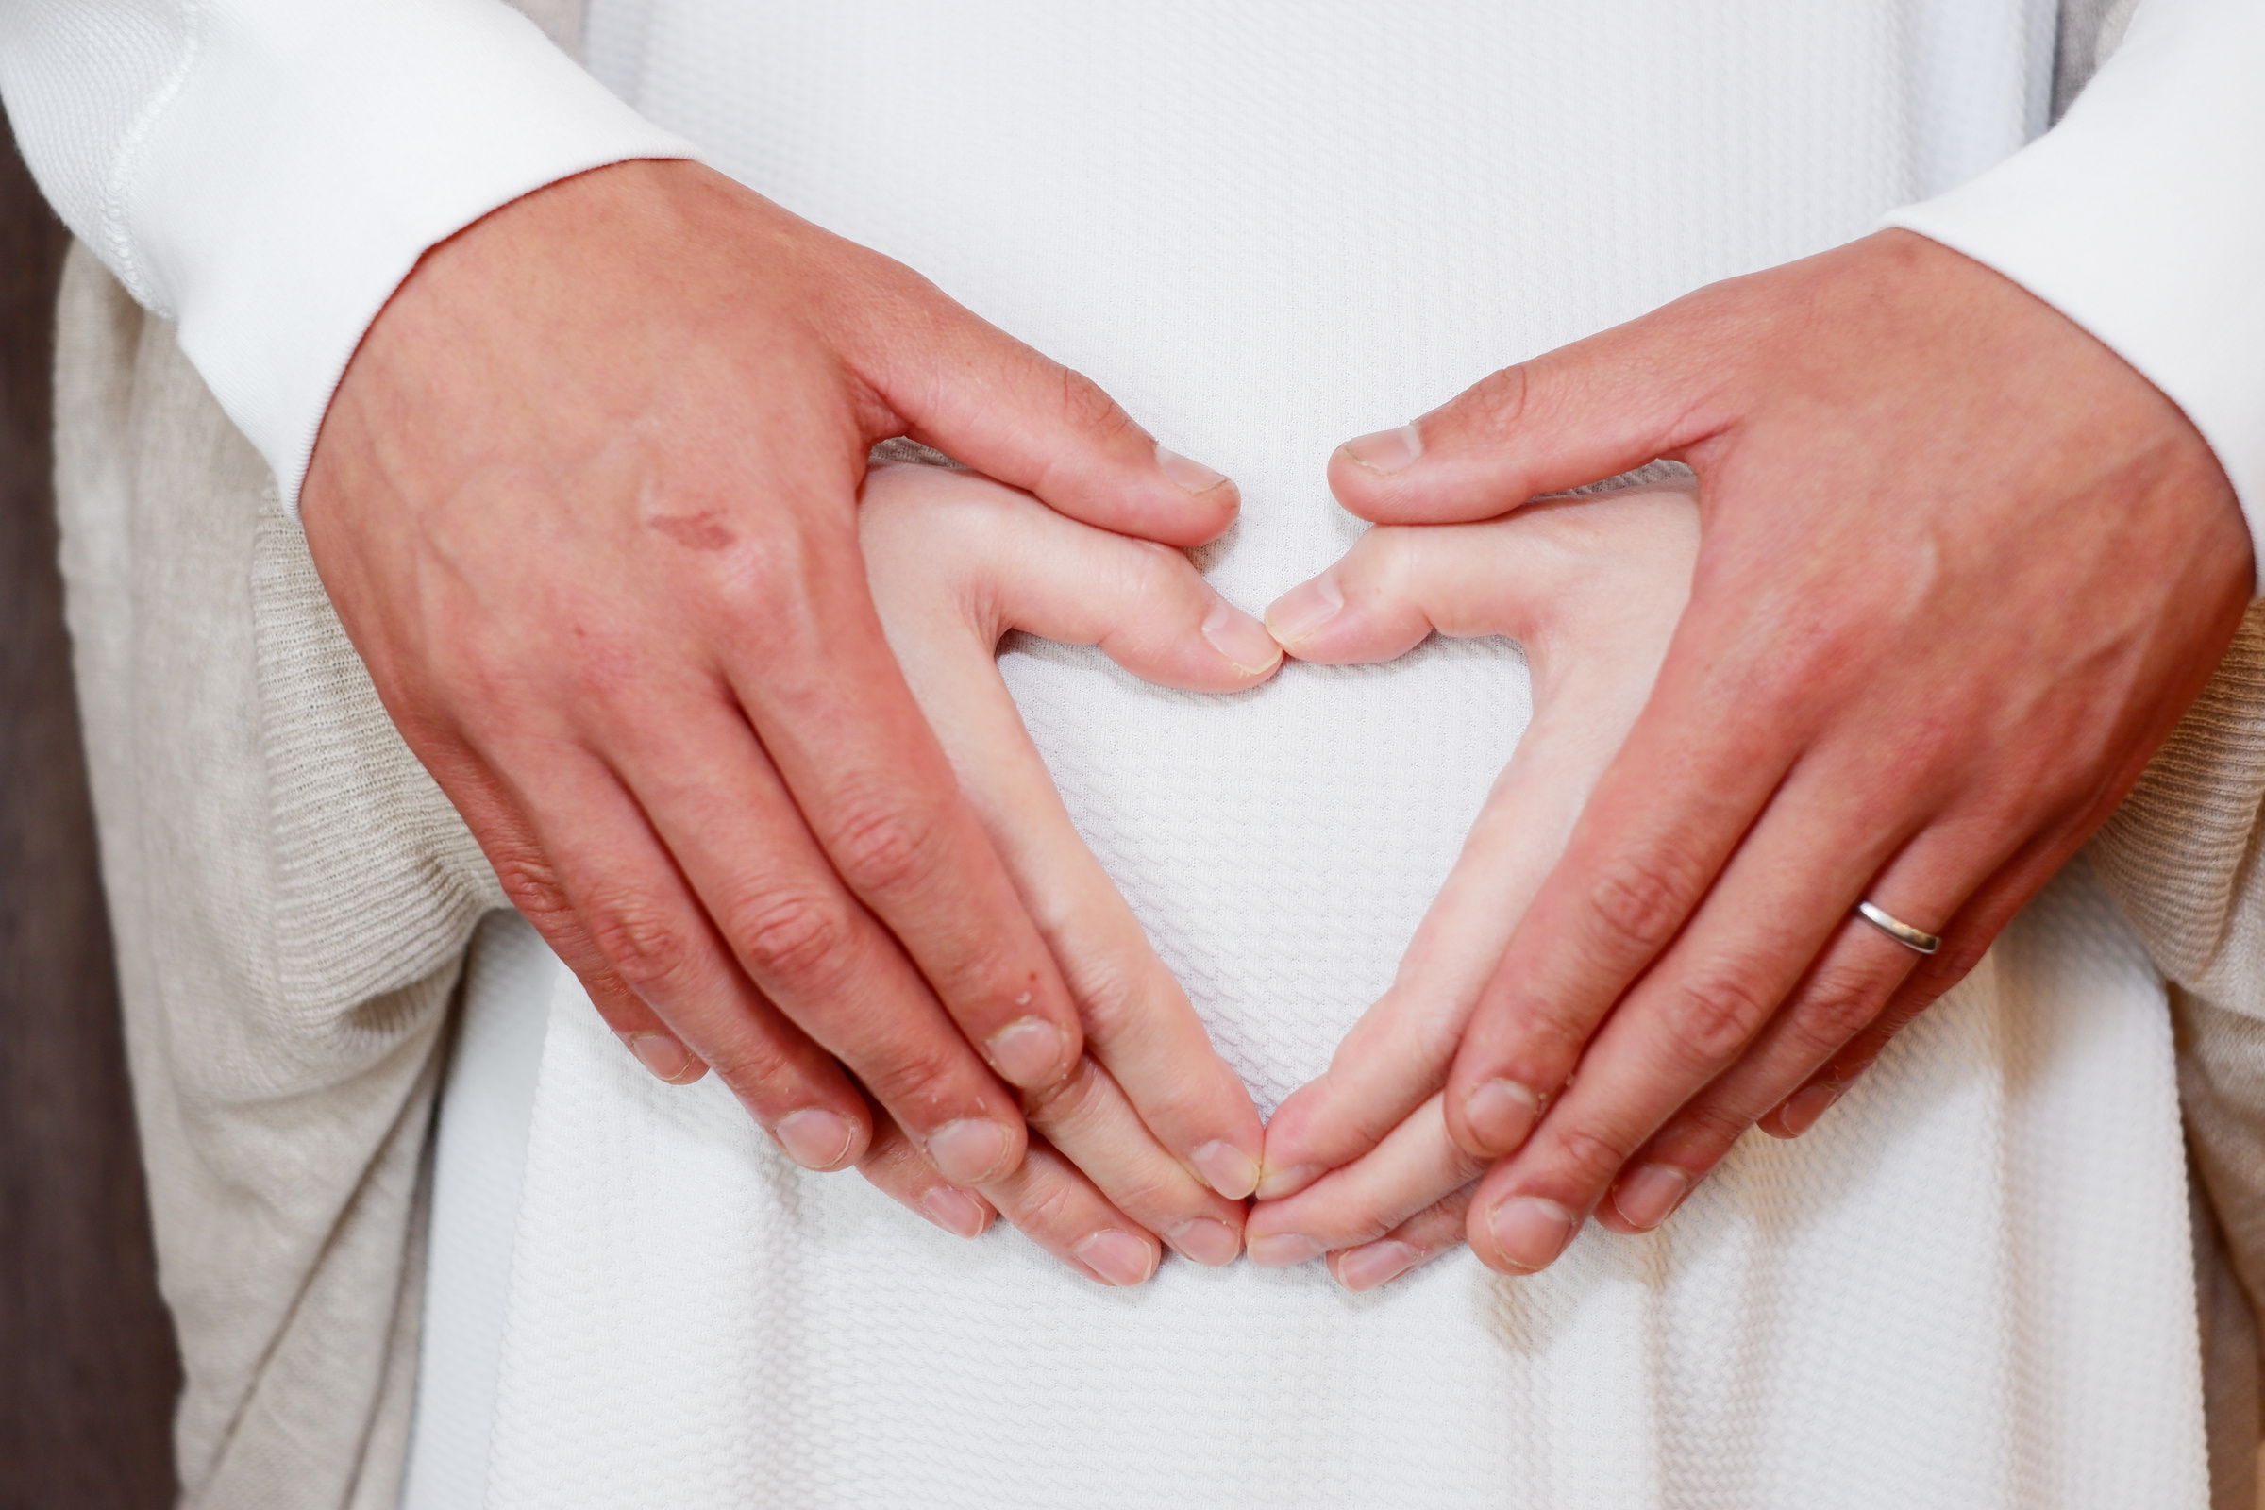
Daily Wellness Routine
Building a consistent daily routine is one of the most powerful things you can do for your pregnancy. Start each morning with a nutritious breakfast and a glass of water. Take your prenatal vitamins at the same time every day to build the habit. Schedule gentle movement, whether a short walk or prenatal stretching, and end the day with a calming wind-down routine. Consistency in small daily habits creates a strong foundation for both your health and your baby's development.

Slide 6

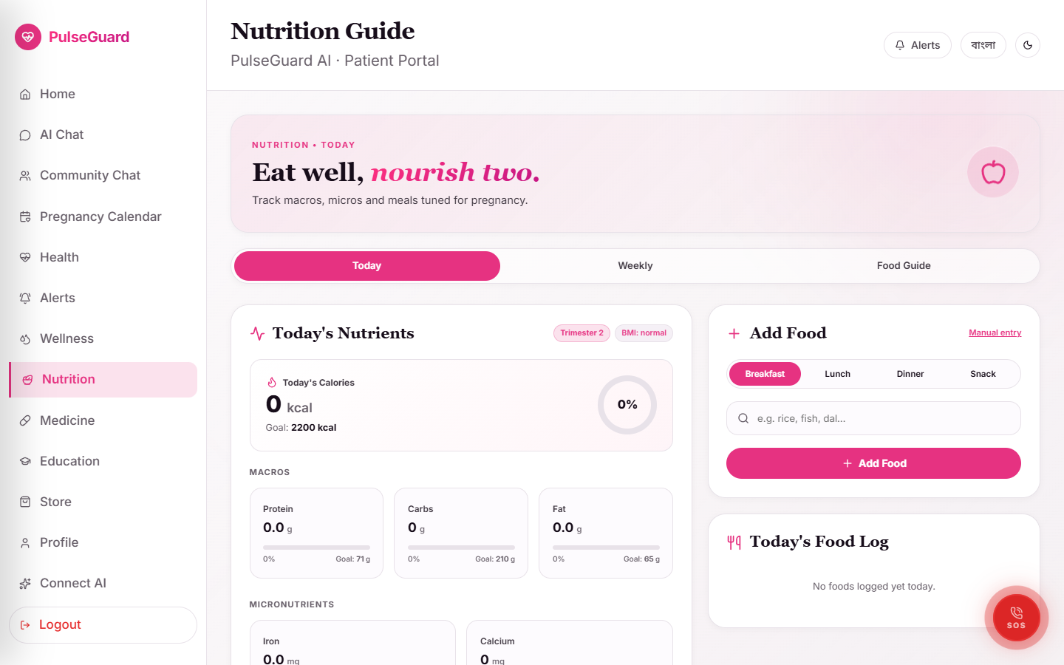
Nutrition during pregnancy is not about eating more — it is about eating right. Focus on iron-rich foods like lentils and leafy greens to prevent anemia, and calcium sources like dairy or fortified alternatives for bone development. Include omega-3 fatty acids from fish or flaxseed for brain development. Limit processed foods, added sugars, and excess sodium. PulseGuard's nutrition tracker helps you log meals and flags nutritional gaps, giving you personalized dietary guidance every day.
Nourishing Your Body

Slide 7

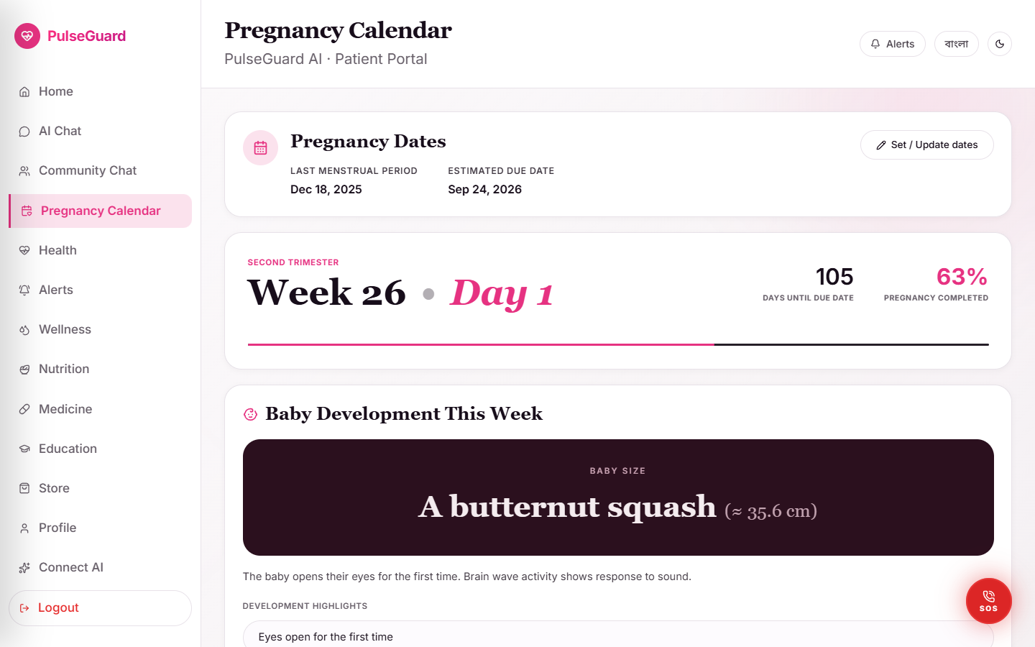
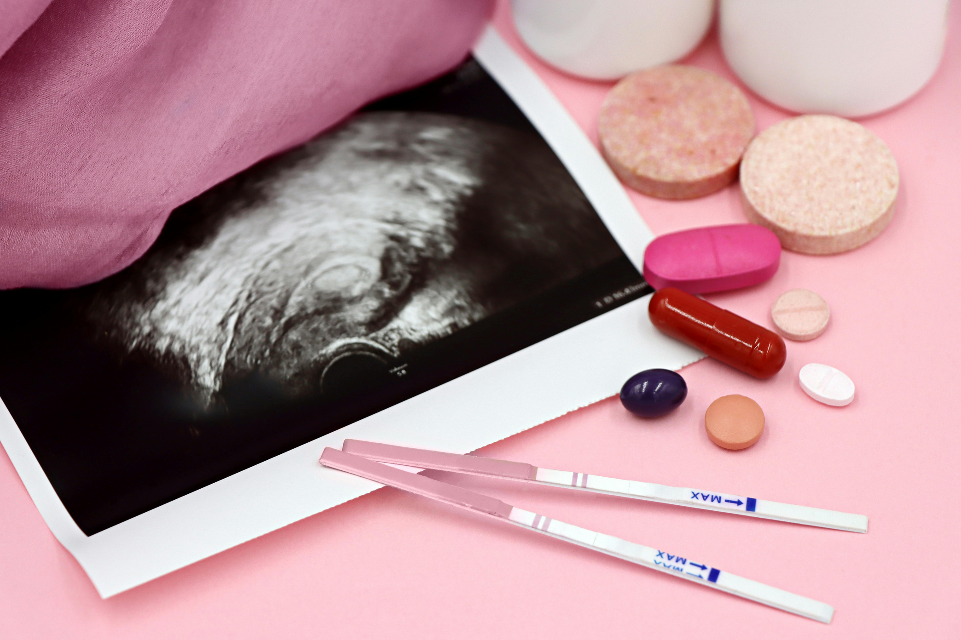
Staying Hydrated and Energized
Dehydration during pregnancy can lead to fatigue, headaches, and even preterm contractions. Aim for 8-10 glasses of water daily, and increase intake during hot weather or after exercise. Herbal teas (pregnancy-safe varieties) and water-rich fruits like watermelon and cucumber count toward your hydration goals. To maintain energy levels, eat small frequent meals every 3-4 hours rather than large meals, focusing on complex carbohydrates and protein for steady blood sugar.

Slide 8
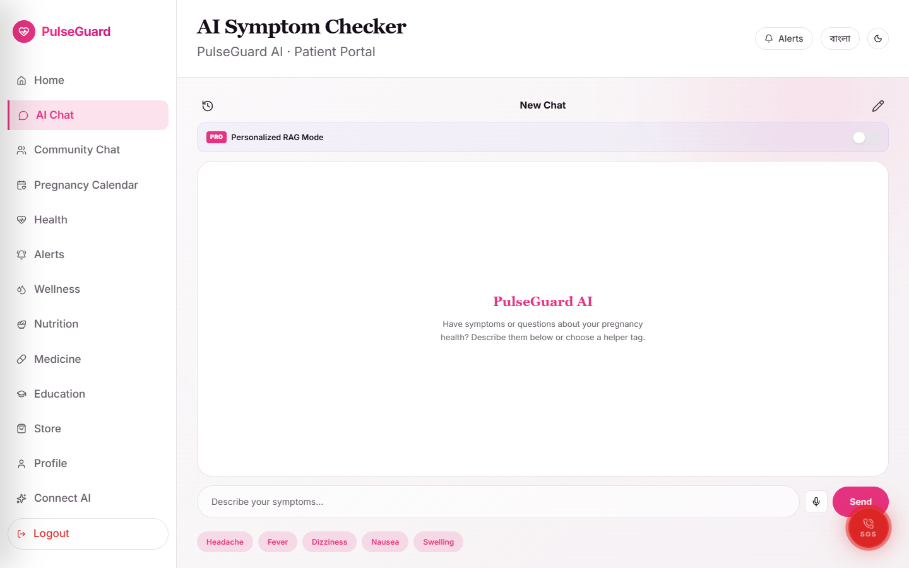

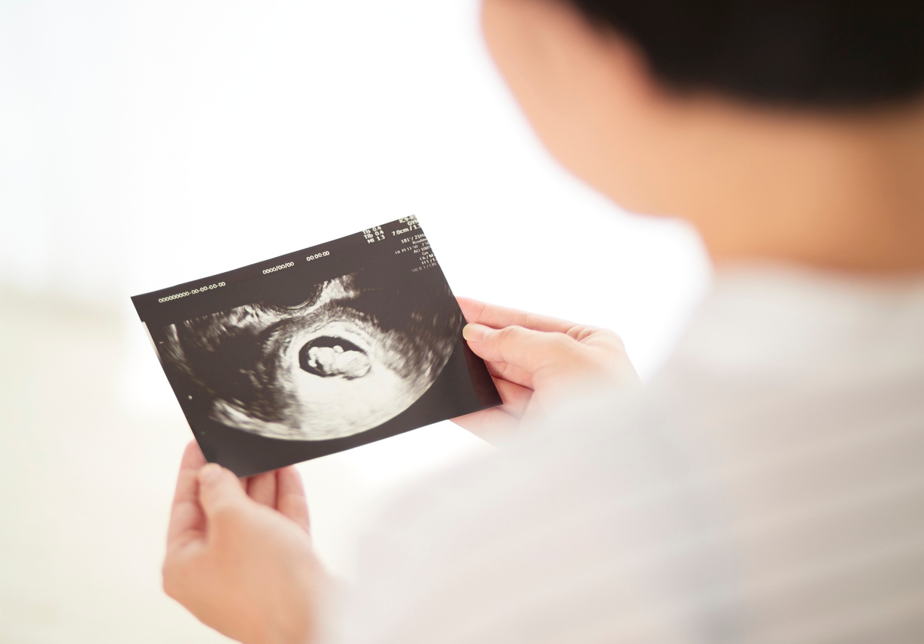

Emotional Wellbeing Matters
Pregnancy brings emotional changes as significant as physical ones. Hormonal shifts, physical discomfort, and anticipation of parenthood can all affect your mental health. It is normal to feel anxious or overwhelmed — but it does not have to be your daily experience. Practice mindfulness, talk openly with your partner or support network, and do not hesitate to seek professional counseling if needed. PulseGuard's wellness check-ins help you track your mood patterns and identify when you may need extra support.

Slide 9

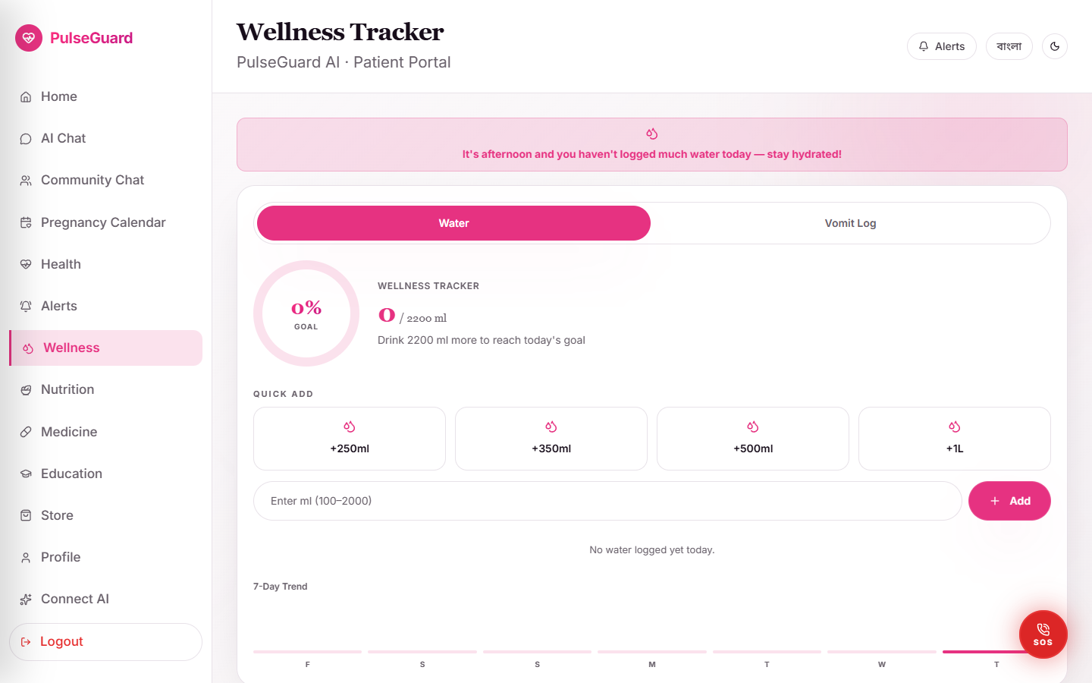
Rest and Sleep Quality
Sleep is essential for fetal development and maternal recovery. Aim for 7-9 hours per night, and rest when you feel tired during the day. Sleep on your left side during the second and third trimesters to improve blood flow to the baby and reduce pressure on your organs. Use a pregnancy pillow for support and keep your bedroom cool and dark. Avoid screens for at least 30 minutes before bed, and try a calming nighttime ritual like light reading or deep breathing.

Slide 10
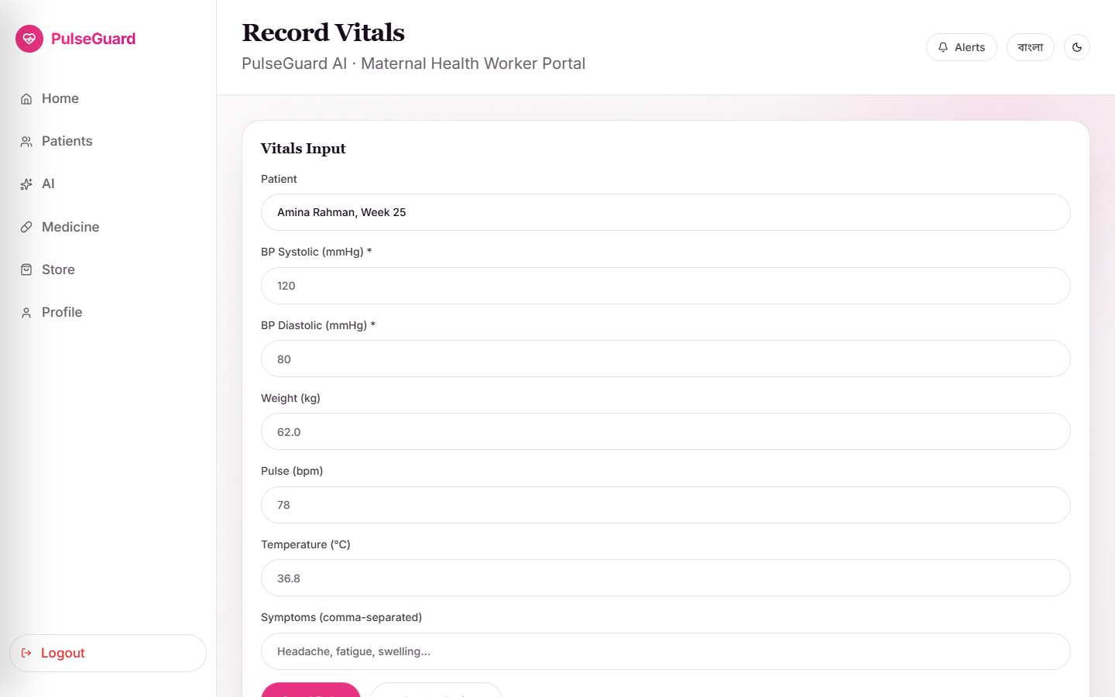
Regular, gentle exercise during pregnancy reduces back pain, improves mood, and prepares your body for labor. Walking, swimming, and prenatal yoga are all safe for most pregnancies. Aim for 30 minutes of moderate activity most days of the week. Avoid exercises that involve lying flat on your back after the first trimester, contact sports, or activities with a high fall risk. Always listen to your body — if something does not feel right, stop and rest. Consult your healthcare provider before starting any new exercise routine.
Safe Movement and Activity

Slide 11
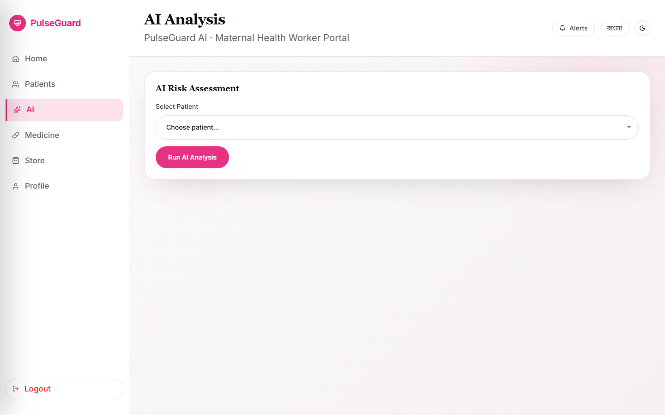
Relaxation and Mindfulness
Stress during pregnancy can affect both mother and baby, making relaxation an essential part of your wellness plan. Practice deep breathing exercises — inhale for 4 counts, hold for 4, exhale for 6 — to activate the parasympathetic nervous system and reduce cortisol. Prenatal meditation, guided imagery, and progressive muscle relaxation are proven tools for reducing anxiety. Even 10 minutes of quiet mindfulness per day can make a meaningful difference in your wellbeing and your baby's environment.

Slide 12
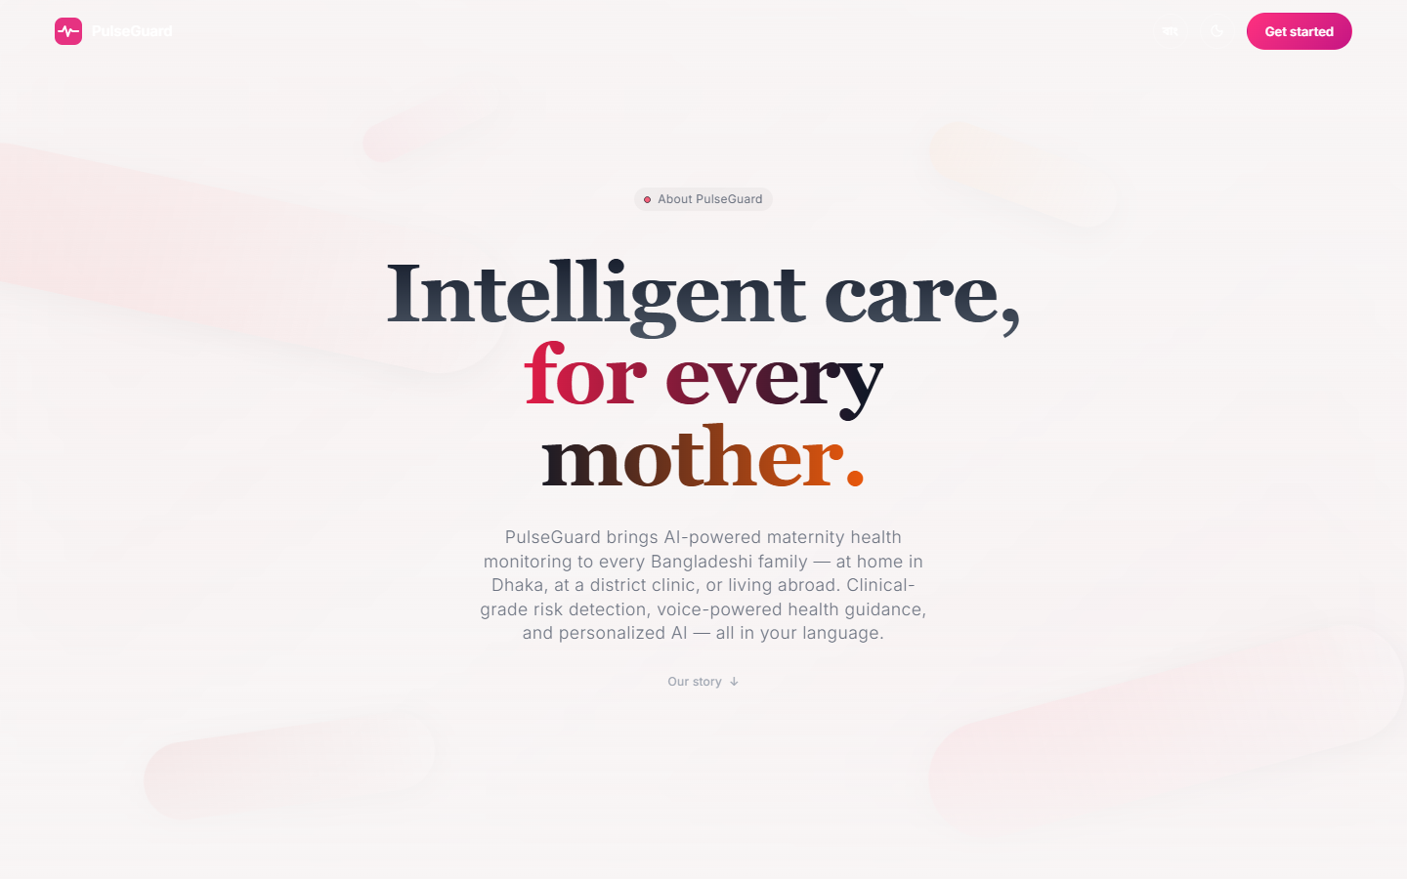
Thank You
Presented by Emily Dawson
Any Questions?

